Slide 1




BHF Glyceryl trinitrate for pre-hospital ultra-acute stroke: Main results from the Rapid Intervention with Glyceryl trinitrate in Hypertensive stroke Trial-2 (RIGHT-2)
Philip M Bath
Stroke Association Professor of Stroke Medicine
On behalf of RIGHT-2 Investigators

Slide 2
Declarations
RIGHT-2:
Funded by British Heart Foundation
Philip Bath:
Stroke Association Professor of Stroke Medicine
NIHR Senior Investigator
Glyceryl trinitrate (GTN, nitroglycerin):
Not licensed for acute stroke

Slide 3
Thanks
Trial Steering Committee
Independent experts:
Graham Venables (TSC Chair/Neurologist; Sheffield), Pierre Amarenco (Neurologist; Paris, France), Keith Muir (Neurologist; Glasgow)
Grant holders:
Philip Bath (Chief Investigator/Stroke Physician; Nottingham), Tim England (Stroke Physician; Derby), Nikola Sprigg (Stroke Physician; Nottingham) , Alan Montgomery (Statistician; Nottingham), Stuart Pocock (Statistician; London), John Potter (Stroke Physician; Norwich), Chris Price (Stroke Physician; Newcastle), Tom Robinson (Stroke Physician; Leicester), Christine Roffe (Stroke Physician; Stoke-on-Trent), Niro Siriwardena (Pre-Hospital Healthcare; Lincoln), Joanna Wardlaw (Neuroradiologist; Edinburgh)
Funder's representative: Shannon Amoils (London)
Patient representative: Malcolm Jarvis (Nottingham)
Sponsor's representative: Angela Shone (Nottingham)
Advisory Committee
Craig Anderson (Sydney, Australia), Eivind Berge (Oslo, Norway), Peter Rothwell (Oxford, UK), Steve Phillips (Halifax, Canada), Else Sandset (Oslo, Norway), Nerses Sanossian (Los Angeles, USA), Jeff Saver (Los Angeles, USA)
Independent Data Monitoring Committee
Peter Sandercock (Chair; Edinburgh, UK): Kjell Asplund (Umeå, Sweden), Colin Baigent (Oxford, UK)
Independent events (SAE) adjudicators
Marc Randall, Sandeep Ankolekar
Neuroimaging adjudicators
Joanna Wardlaw (Chair; Edinburgh, UK), Lesley Cala (Perth, Australia), Grant Mair (Edinburgh, UK)
Ambulance Services
Paramedics
Hospitals
Coordinators
And the Patients and Relatives

Slide 4
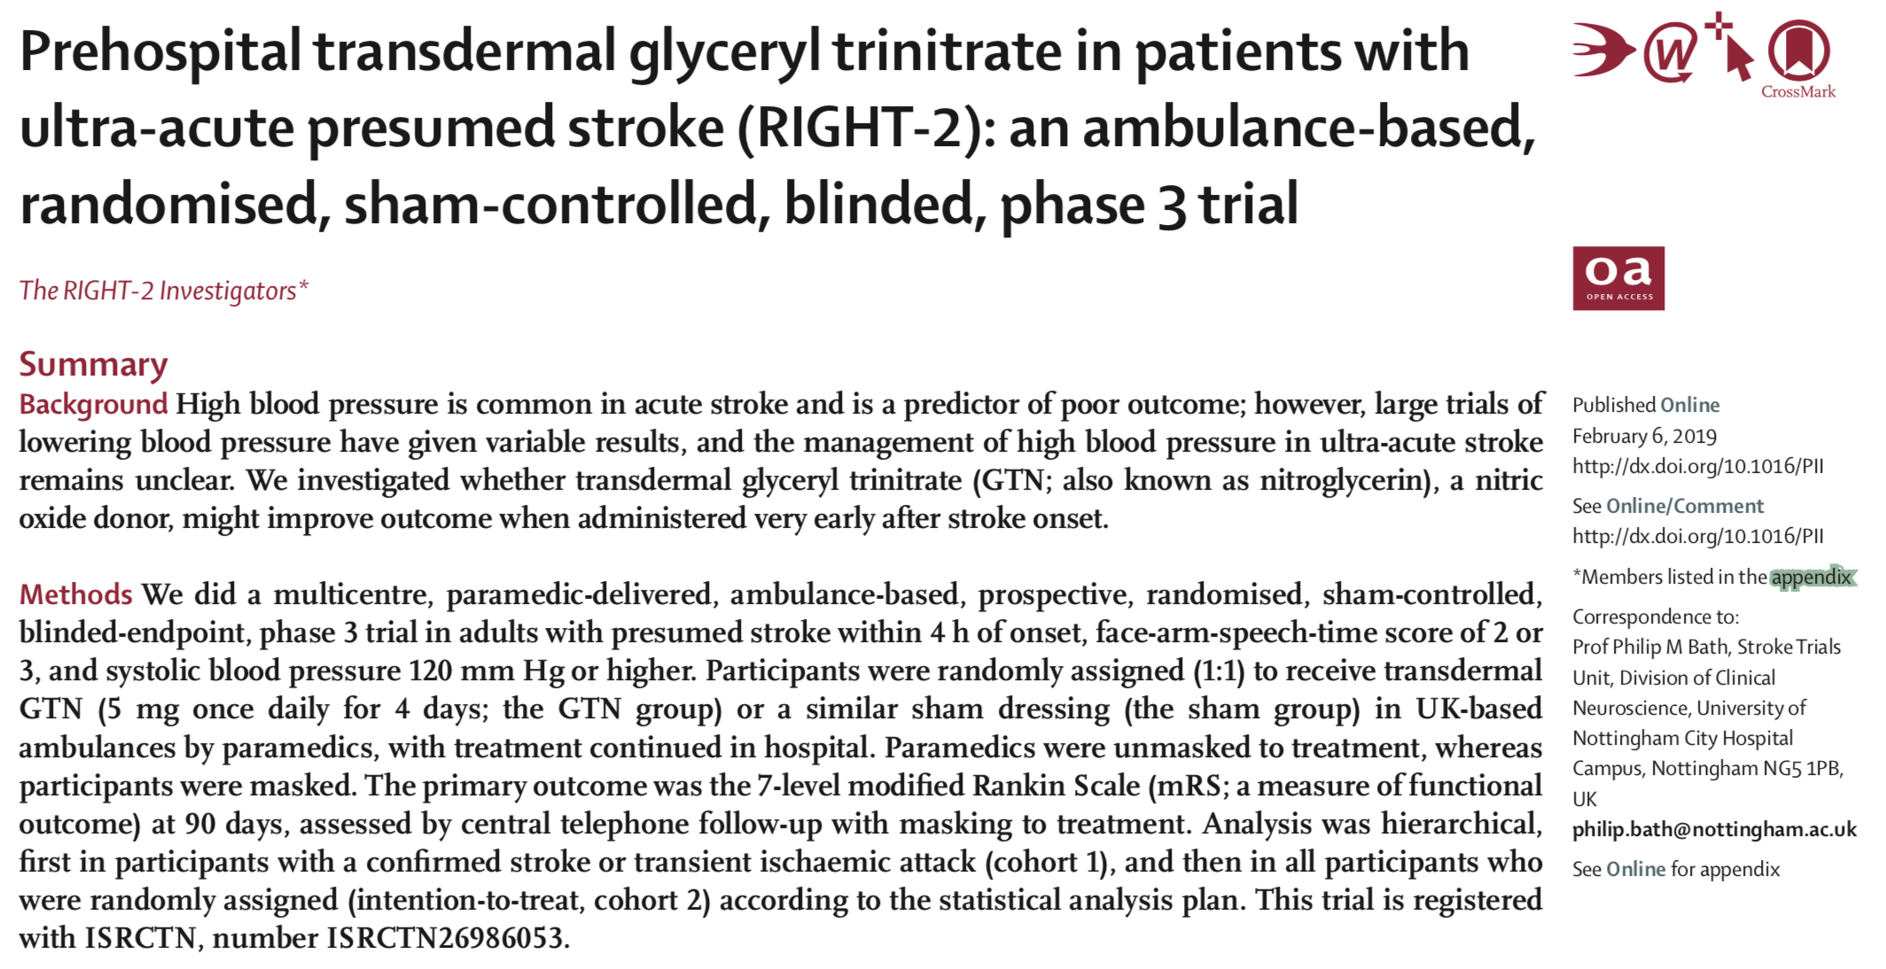
Publication: Lancet 6 Feb 2019

Slide 5
Background
Nitric oxide is a fundamental regulatory molecule
Vasodilator, anti-leukocyte, anti-platelet, neurotransmitter, …
Nitric oxide (nitrite/nitrate) level low in acute stroke
Glyceryl trinitrate (GTN, a NO donor) safe in acute stroke
ENOS (n=4011) neutral
GTN improves outcome in ultra-acute/hyper-acute stroke
RIGHT pilot trial, ENOS-early subgroup
Time-dependent: very early best
Effective in both IS and ICH
NO donors are neuroprotective in experimental ischaemic stroke
Time-dependent
Rashid et al. J Stroke Cerebrovasc Dis 2003; 12: 82-87
Willmot et al. Hypertension 2006; 47:1209-15
ENOS Trial Investigators. Lancet 2015; 385: 617-28
Bath et al, BASC. Stroke Res Treat 2016; ID9706720
Willmot et al. Nitric Oxide 2005; 12: 141-9

Slide 6
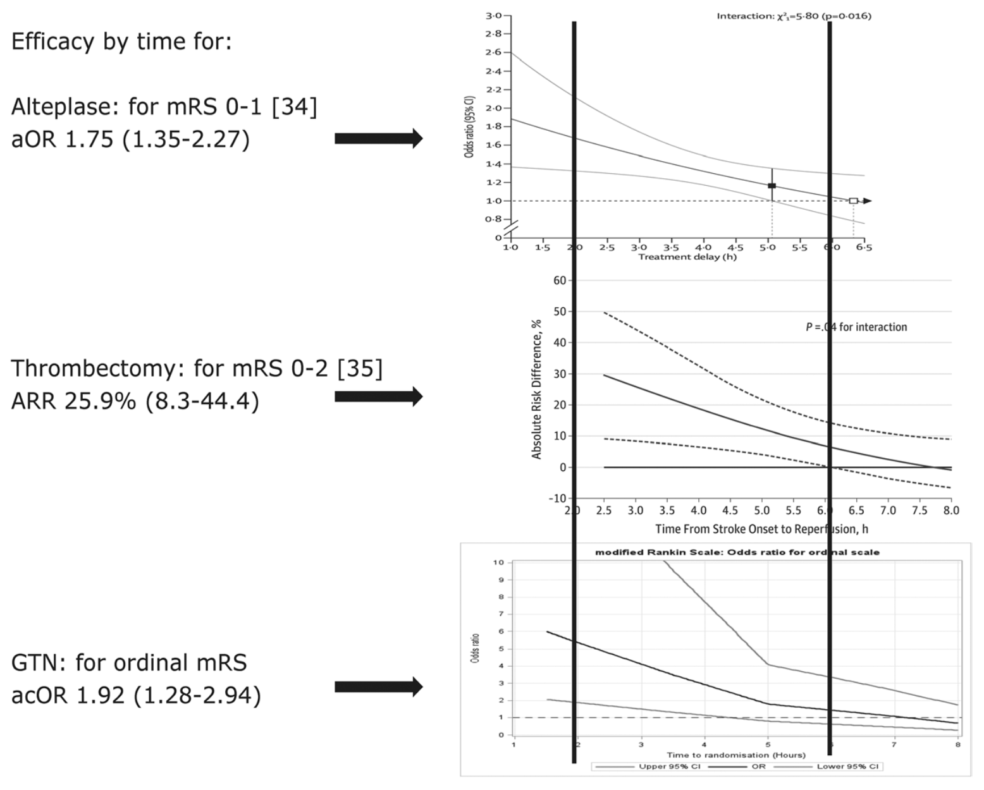
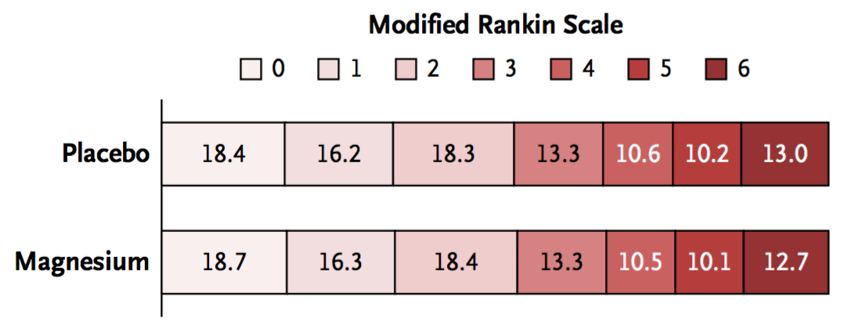
Time is brain
Only effective interventions have time-dependency:[1]
Alteplase [2]
Thrombectomy [3]
GTN? Pilot data [4]
Large Ambulance trials feasible, at least in US
FAST-Mag [5]
1. Bath. Stroke 2016; 47:2423-6
2. Emberson et al. Lancet 2014; 384: 1929-35 N=6,756
3. Fransen et al. JAMA Neurology 2015; 21 December N= 500
4. Bath, Woodhouse et al. Stroke Res Treat 2016; 9706720 N= 312
5. Saver et al. NEJM 2015;372:528-36 N=1,700

Slide 7
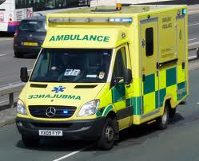
RIGHT-2: Design
Multicentre, parallel-group, prospective, randomised, single-blind, blinded-endpoint controlled trial
Main phase: May 2015 – April 2018
850 patients from 5+ ambulance services and 30+ associated acute hospital stroke centres
Primary outcome/analysis at day 90: modified Rankin scale
Day 0
Day 4
Day 90
GTN
R
No GTN
Appleton et al. Int J Stroke 2017 1 August Protocol
Notes:
7

Slide 8
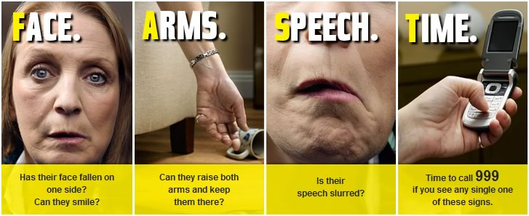
Patients: Inclusion/exclusions
Inclusion
Patients presenting to paramedics in context of 999 ambulance call for ‘stroke’
Ages 18 years or more
‘Face/Arm/Speech’ Time (FAST) score ≥2
Time ≤4 hours of onset
Systolic BP ≥120 mmHg
Paramedic:
Trained in RIGHT-2 procedures
Will take patient to a participating hospital
Written or witnessed oral consent, or relative/paramedic proxy assent
Exclusion
Patient at a Nursing Home
Capillary glucose <2.5 mmol/l
Glasgow Coma Scale <8
Witnessed seizure/fit at presentation
Known life expectancy <6 months
Known to have taken a PDE5 inhibitor, e.g. sildenafil, in previous day before stroke
Known sensitivity to Transiderm Nitro patch
Known sensitivity to Duoderm hydrocolloid dressing
Appleton et al. Int J Stroke 2017 1 August Protocol

Slide 9
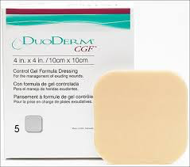
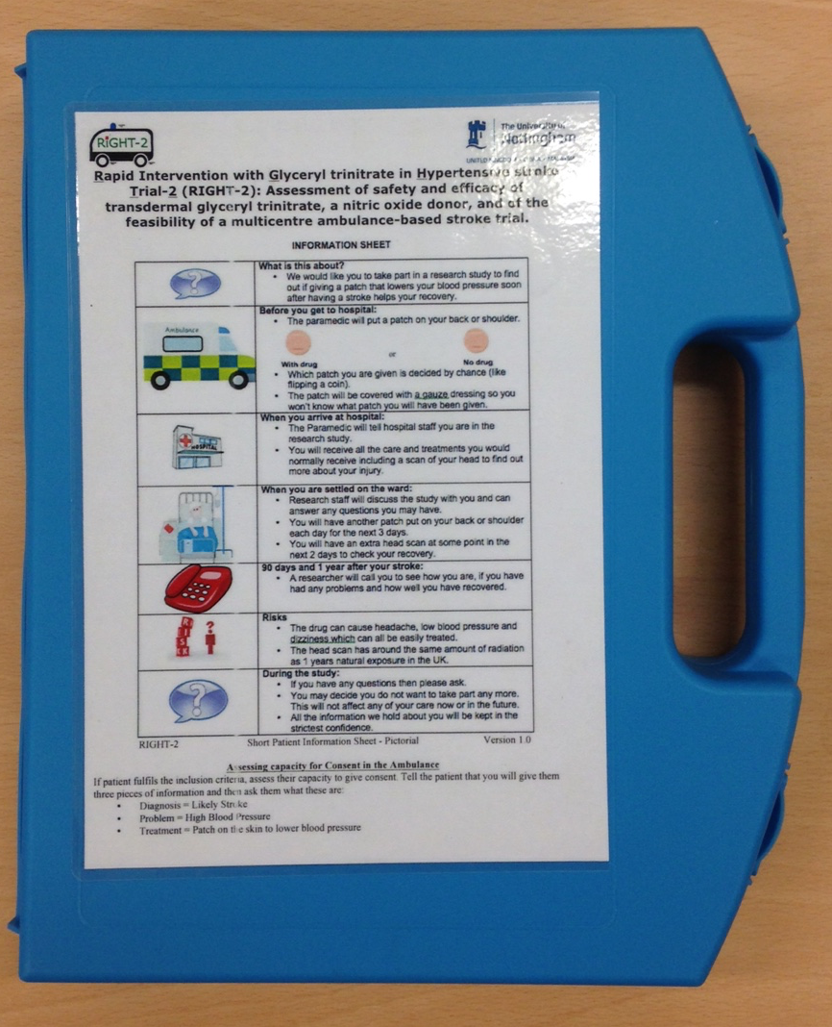
Intervention & comparator
Active patch:
Transdermal GTN 5 mg daily
Transiderm Nitro ‘5’ (Novartis)
Unlabelled patch in labelled sachet
Sham dressing
Hydrocolloid dressing - 4.4 cm x 3.8 cm
Duoderm
Unlabelled patch in labelled sachet
4 patches (GTN/Sham) packed in a ‘first-aid’ box by Nottingham University Hospitals NHS Trust Pharmacy
Appleton et al. Int J Stroke 2017 1 August

Slide 10
Key protocol changes
Original protocol
Analyse all population [1] (as in RIGHT [2])
Comparison of GTN vs sham
Observation
Higher than expected mimic rate (26% v 12%) so risk of dilution of treatment effect
Changed protocol (blinded to treatment assignment)
Increase sample size 850 → 1050 (with additional funding)
Change to hierarchical analysis to prevent dilution [3]
Explanatory analysis in target population (stroke + TIA). If positive
Pragmatic analysis in whole population (ITT)
Appleton et al. Int J Stroke 2017 1 August Protocol
Ankolekar et al. Stroke 2013; 44: 3120-8 N=41
Scutt et al. Eur J Stroke 2018; 3 Jan SAP

Slide 11
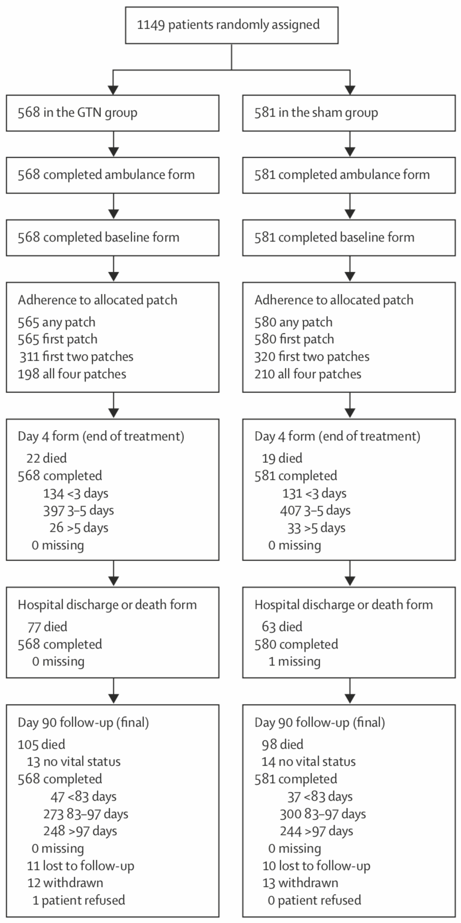
CONSORT: in All (ITT)
Randomised 1149
GTN 568
Sham 581
Adherence
First patch >99%
First 2 patches 57%
Follow-up day 90
mRS 1102 (96%)
Vital status 1122 (98%)
Died 203
Missing 0
Lost to follow-up 21
Withdraw 25
Refused 1
RIGHT-2 Investigators. Lancet 2019; in press

Slide 12
Baseline, ambulance: in All (ITT)
 | GTN | Sham
N, pre-randomisation | 568 | 581
Age (years) | 72 (15) | 73 (15)
Sex, male (%) | 294 (52) | 300 (52)
OTR (mins) | 70 [45-115] | 72 [45-118]
ECG, AF/flutter (%) | 92 (21) | 95 (20)
SBP (mmHg) | 162 (25) | 163 (26)
DBP (mmHg) | 92 (19) | 92 (17)
Heart rate (bpm) | 82 (18) | 83 (19)
GCS <14 (%) | 162 (29) | 140 (24)
FAST =3 (%) | 343 (60) | 347 (60)
Ethnic, non-white (%) | 50 (9) | 63 (11)
Pre-morbid mRS >2 (%) | 115 (20) | 108 (19)
Previous stroke (%) | 137 (25) | 135 (24)
Ischaemic stroke (%) | 302 (53) | 295 (51)
Intracerebral haemorrhage (%) | 74 (13) | 71 (12)
TIA (%) | 57 (10) | 52 (9)
Mimic (%) | 134 (24) | 163 (28)
Balanced
Of stroke (n=743)
IS 80%
ICH 20%
RIGHT-2 Investigators. Lancet 2019; in press

Slide 13
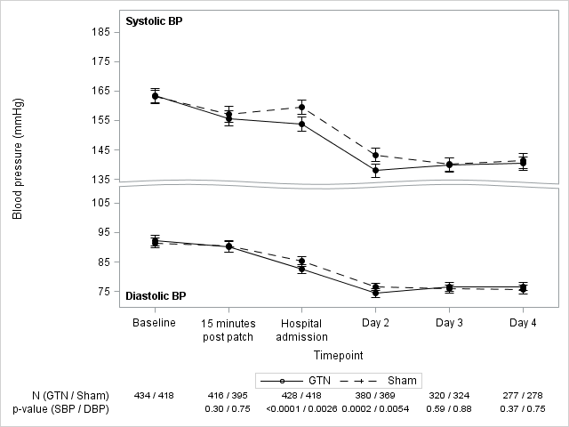
SBP/DBP (mmHg): in Stroke/TIA
-5.7 -5.3 mmHg
-2.6 -2.1
RIGHT-2 Investigators. Lancet 2019; in press

Slide 14
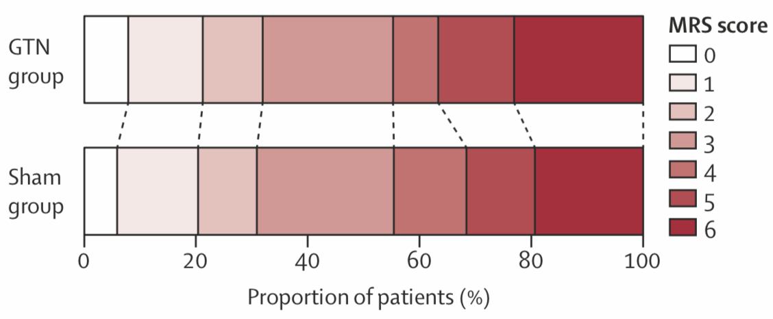
Primary outcome: in Stroke/TIA
Poor outcome acOR 1.25 (0.97, 1.60), p=0.083
> Trial neutral in target population
RIGHT-2 Investigators. Lancet 2019; in press N=828

Slide 15
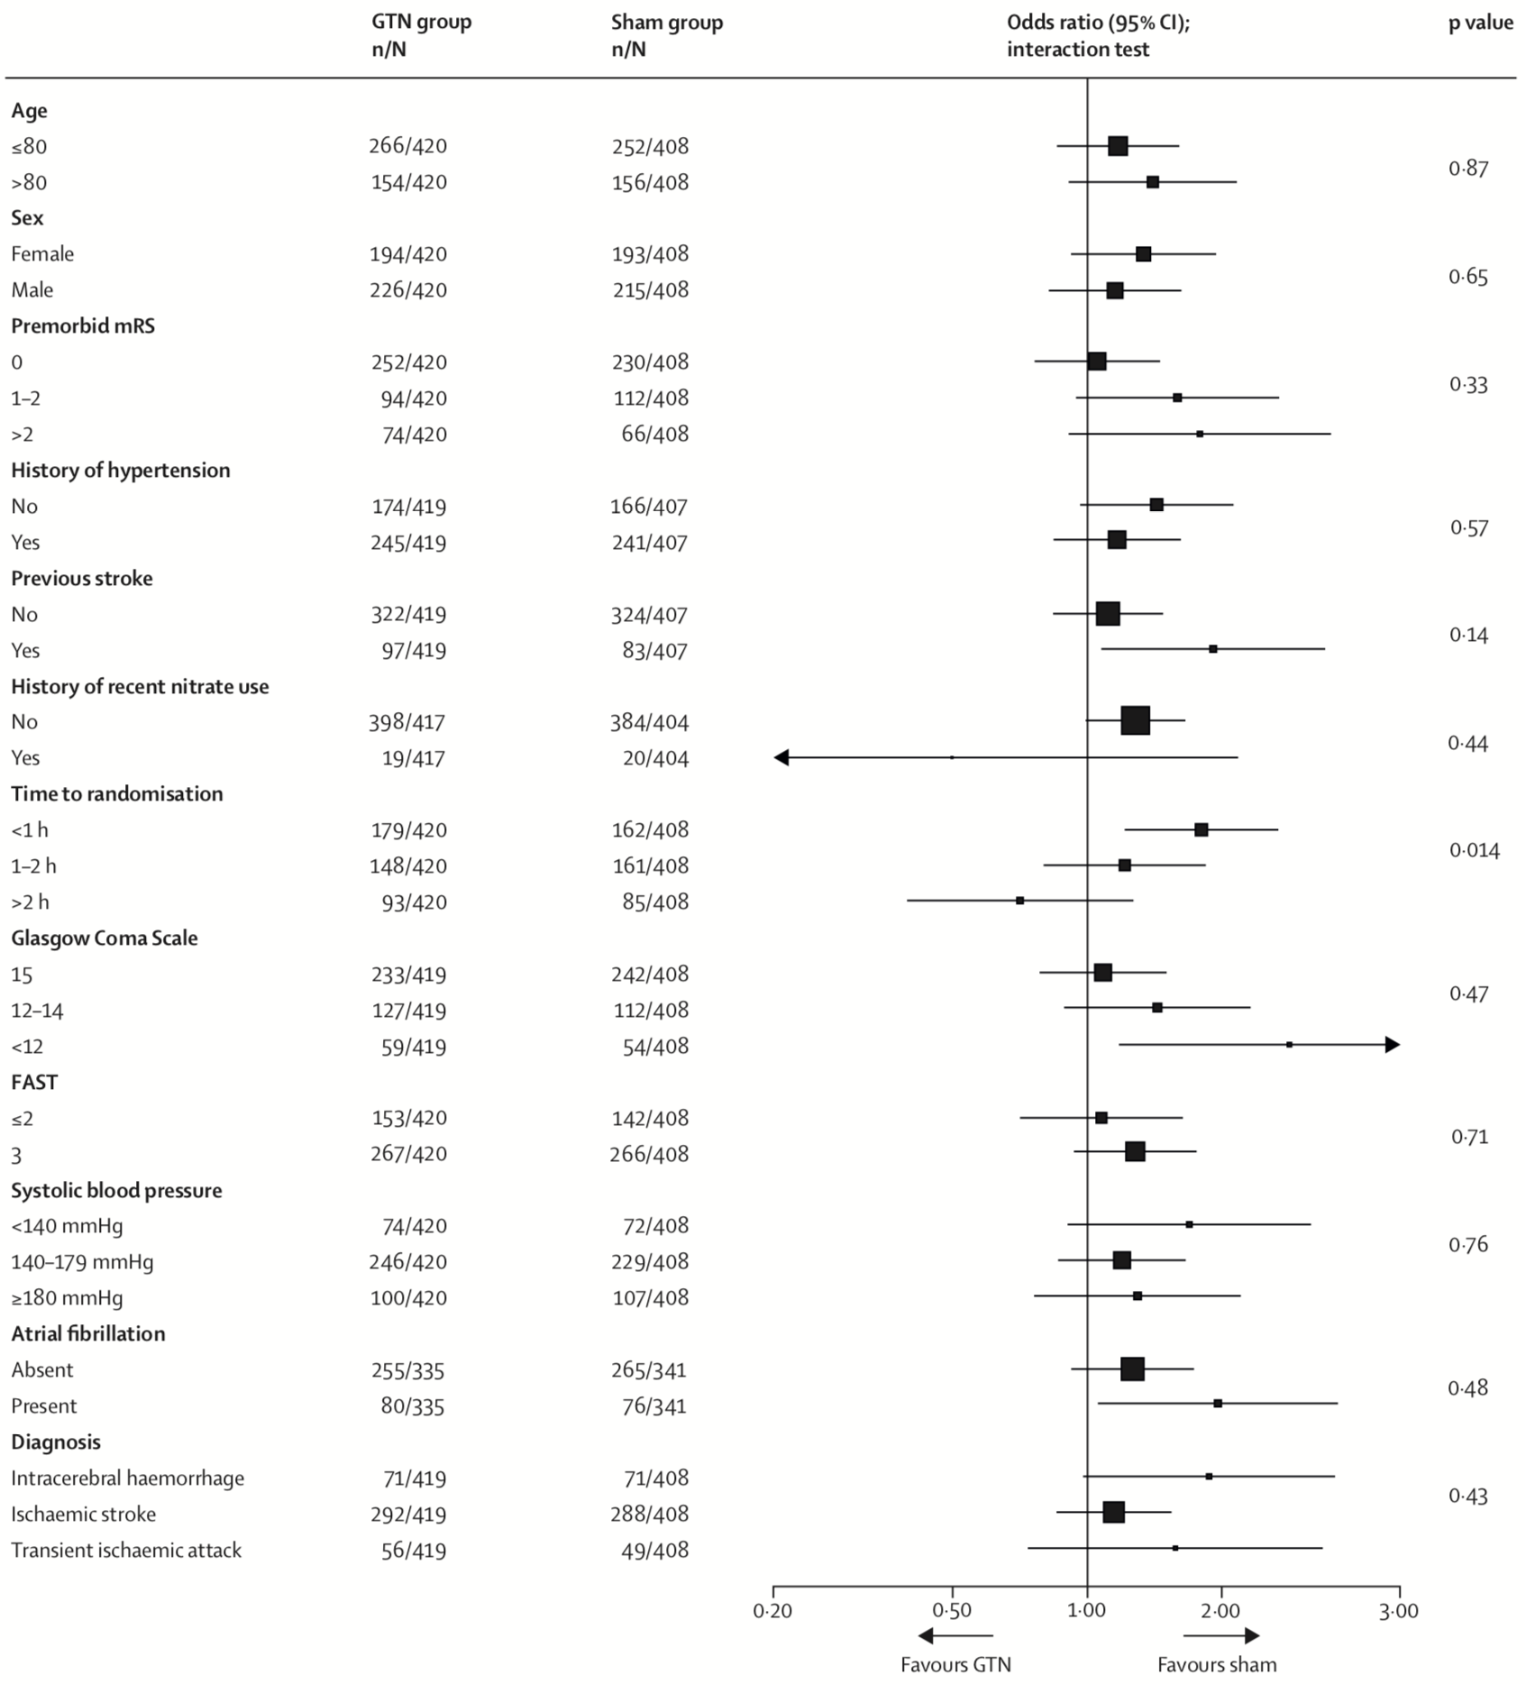
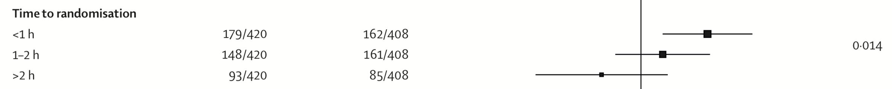
mRS by subgroups: in Stroke/TIA
One interaction:
Time: GTN worse when given very early
No interactions:
Age
Sex
Pre-morbid mRS
HT
Previous stroke
Previous nitrate
GCS
FAST
SBP
AF
Diagnosis
RIGHT-2 Investigators. Lancet 2019; in press

Slide 16
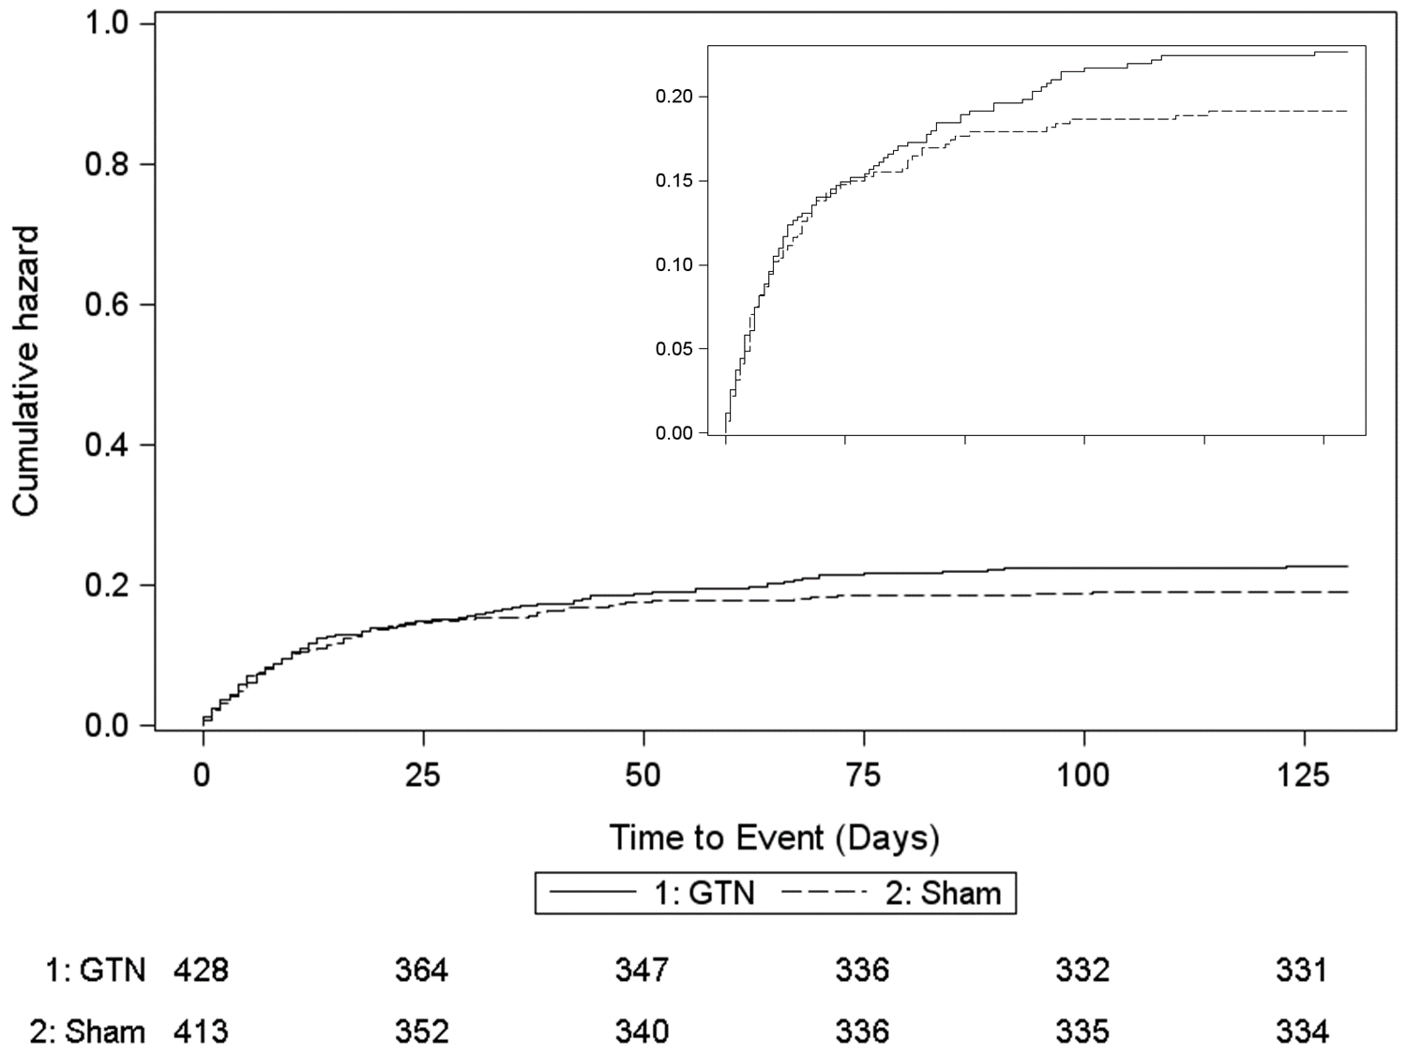
Death: in Stroke/TIA
GTN Sham
23% 19% aHR 1.24 (0.91, 1.68), p=0.17
> No difference in death
RIGHT-2 Investigators. Lancet 2019; in press

Slide 17
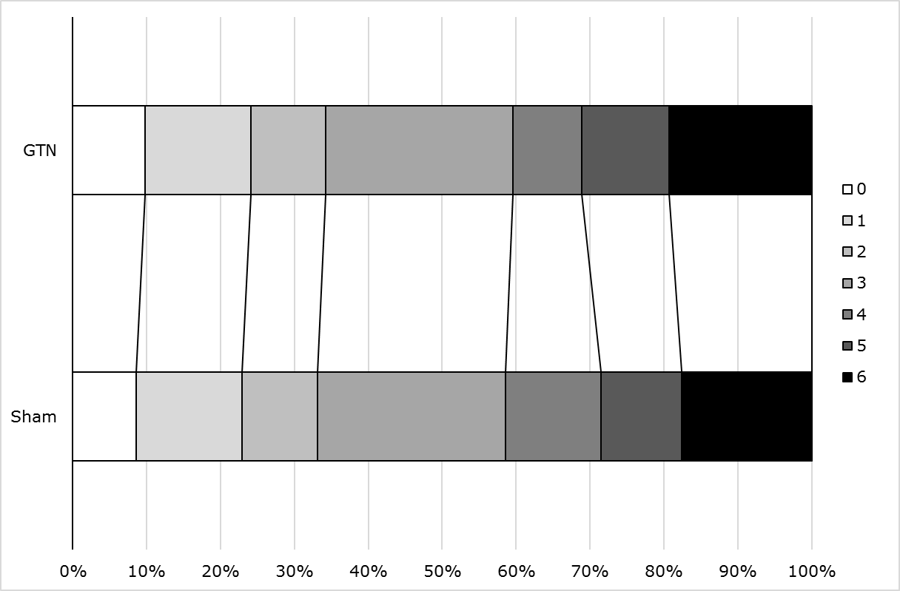
Primary outcome (mRS): in All (ITT)
Explanatory analysis not positive so hierarchical pragmatic analysis not necessary, but
N=1102
GTN
Sham
Poor outcome acOR 1.04 (0.84, 1.29), p=0.69
> Neutral trial in intention-to-treat population
RIGHT-2 Investigators. Lancet 2019; in press N=1102

Slide 18
Strengths Limitations
Large pre-hospital trial
Very early treatment [71 mins]
Blinded outcomes
Blinded adjudication
Good compliance to first treatment
Hierarchical analysis novel – potentially useful for future trials
Single-blind trial
UK-only trial
Change to protocol
Smaller than expected BP difference
Poor adherence on days 2-4
Higher than expected mimic rate

Slide 19
Summary
UK multicentre ambulance-based paramedic-led trial:
Feasible (supports FAST-MAG)
GTN:
In stroke/TIA (target)
mRS: Neutral
In All (ITT)
mRS: Neutral
Mimics: Safe
SAEs: Neutral
RIGHT-2 vs ENOS-early
Neutral vs positive
OTR: 70 mins vs 264 mins
GTN
No indication for use by paramedics pre-hospital
RIGHT-2 Investigators. Lancet 2019; in press

Slide 20
Thank you for listening
And many thanks to patients, investigators and our families

